Slide 1
Transportation Sign In/Out (web app)
Cory Lewis || Gerald Jumper

Slide 2
Requirements:
Follow COS programming language standards (ASP.Net)
Use Microsoft sql server - for database
Use model view controller (mvc) for program structure
Prevent SQL injection

Slide 3
Views:
Choose: Vehicle or Gas Card
Choose: checkout or Return
Fill out form
Return to index (first view)

Slide 4
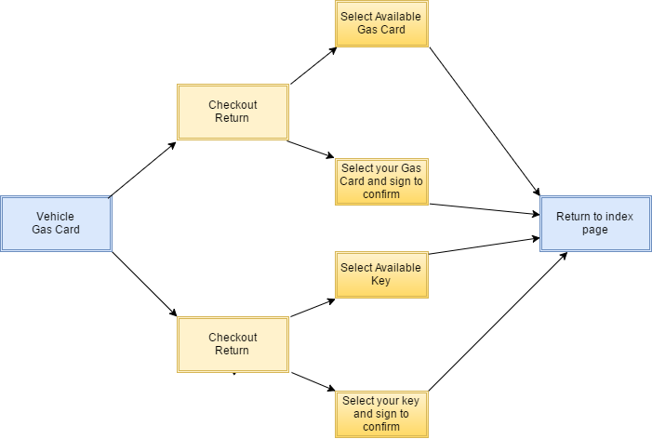

Slide 5
Database structure
Next slide

Slide 6
Admin Settings panel:

Slide 7
Future add-ons:
Admin panel for – settings || reports
Add a request form
Insert request form data into a calendar
Use calendar to create a pending queue of requests
Notify users of late returns via email or text

